Slide 1

Sales and Profitability Performance Dashboard
🔹 Overview This dashboard provides a consolidated view of sales and profitability performance across categories, sub-categories, ship modes, and states. It combines KPIs with supporting visuals to highlight key business drivers. `
BY: Chandana Gowri D A

Slide 2
📌 Key Metrics
2.30M
286.4K
793
3.79
Total Sales
Total Profit
Total Customers
Average Quantity per Order
📈 Visual Analysis

Slide 3
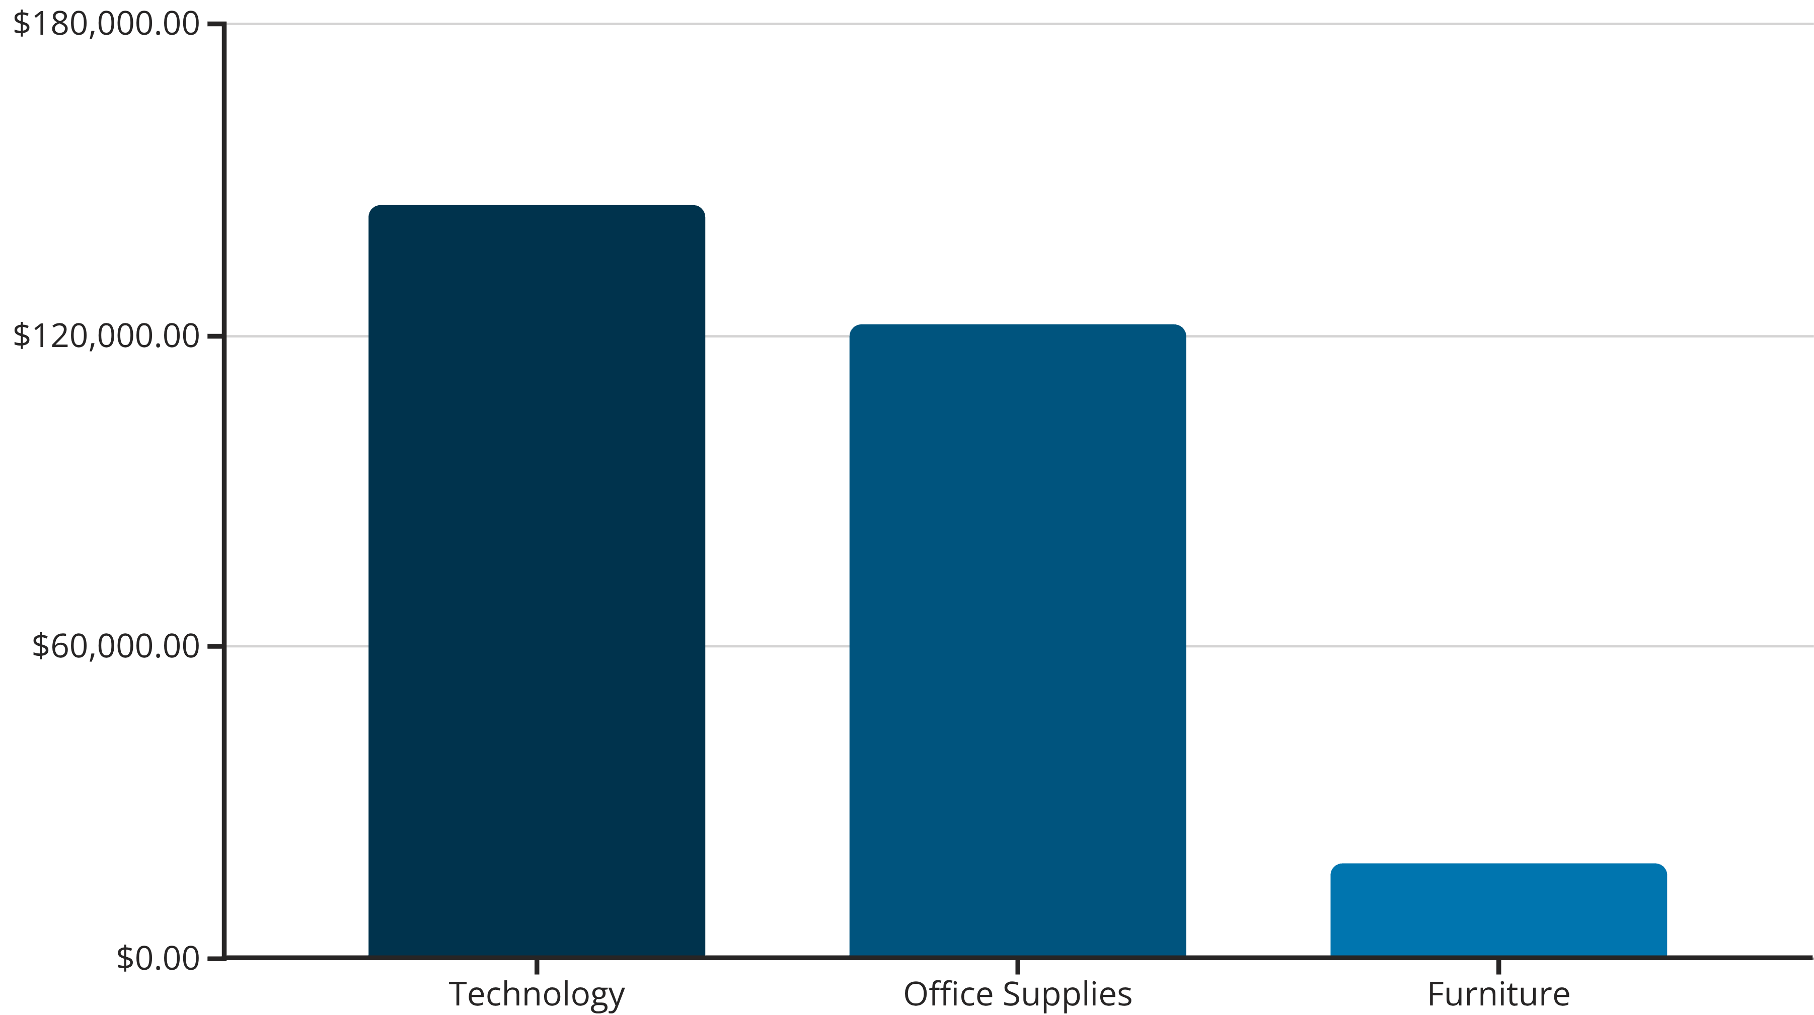
1. Profit by Category
Technology: 145K profit → highest contributing category.
Office Supplies: 122K profit → strong performer.
Furniture: 18K profit → lowest profitability (possible cost or discount issues).
👉 Insight: Furniture sales may need cost optimization or pricing review.

Slide 4

3. Profit by State
A geographical heatmap shows profit distribution across states.
👉 Insight: Certain states outperform significantly, highlighting regional market differences.

Slide 5
4. Top 5 Sales by Sub-Category
1
Phones
330.01K (100% benchmark)
2
Chairs
328.45K (≈99%)
3
Storage
223.84K (61.6%)
4
Tables
206.97K
5
Binders
203.41K
👉 Insight: Phones and Chairs are top revenue drivers, but sub-categories like Tables might generate sales with low profitability (to be checked).

Slide 6
📊 Insights Summary
Technology is the most profitable category; Furniture lags significantly.
Phones & Chairs lead sales, but profit distribution by sub-category needs deeper analysis.
Standard Class shipping dominates (60% of sales), but fast shipping adoption is low.
Regional differences in profit suggest location-specific strategies could improve performance.
While sales volume is strong, overall profit margins (12.4%) show potential for optimization.

